Slide 1
Getting Started With React
Starter React Webpage | Create React App | A Similar React App |
Notes:
Welcome to our lecture on basic introduction to react. In this lecture we will go through basics of react webpage, how to create a react app, and will explore similar react apps. Let’s start the video lecture.

Slide 2

Starter React Webpage
React is a JavaScript library for building interactive user interfaces, allowing developers to create custom HTML elements with JavaScript-defined behavior.
ReactDOM.createRoot() initializes a root DOM node managed by React, typically the main entry point of the application.
Root.render() renders React elements into the root DOM node using a virtual DOM for efficient updates.
Notes:
React is a powerful JavaScript library for building interactive user interfaces. It allows developers to create reusable components with JavaScript behavior. The React DOM create root function initializes the main root element that React manages. Then, the render method places React elements into the root using a virtual DOM for efficient updates. Next, we will explore how React efficiently updates the UI.

Slide 3
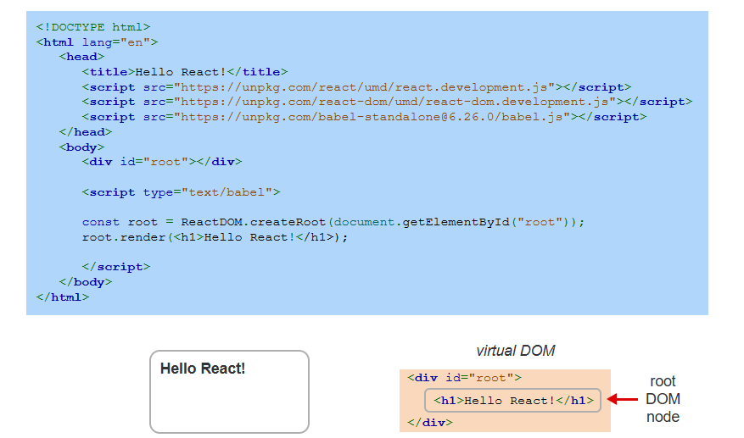
Example
Notes:
This example shows how to create a simple React webpage. The HTML file includes React and React DOM via script tags. A root div is defined, and the React DOM create root function attaches React to this element. The render method inserts a heading into the root using the virtual DOM. This approach efficiently updates content without directly modifying the browser DOM. Next, we will explore creating React components.

Slide 4
Create React App
Create React App provides a pre-configured setup for building React applications efficiently and simplifies debugging.
Node.js must be installed to use Create React App, as it includes necessary tools like npm and npx.
npx allows developers to quickly create a React project by executing packages from the npm registry without manual setup.
Notes:
Create React App is a tool that provides a pre-configured environment for building React applications efficiently. It simplifies debugging and eliminates the need for manual setup. To use it, Node.js must be installed, as it includes NPM and NPX. The NPX command allows developers to quickly generate a new React project from the NPM registry. Next, we will see how to create and run a React project using this tool.

Slide 5
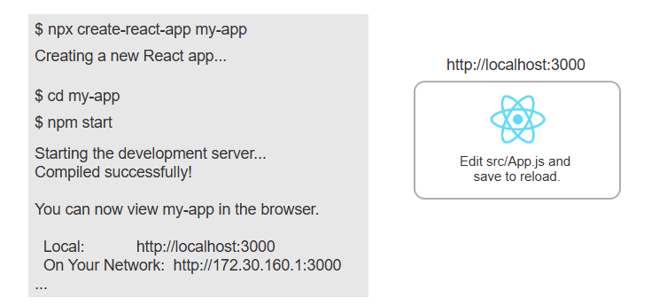
Example
Notes:
This example shows how to create a new React app using Create React App. The NPX command initializes a new project named my app. After navigating into the project folder, the NPM start command launches the development server. The app runs locally on port 3000 and updates automatically when changes are made. This setup simplifies starting a React project. Next, we will explore the project structure and key files.

Slide 6
A Similar React App
Simplifying a React project helps new developers understand the core concepts without unnecessary complexity.
Modifying key files reduces the default setup while maintaining essential React functionality.
A minimal project structure makes it easier to focus on learning React without extra configurations.
Notes:
Simplifying a React project helps new developers focus on learning the core concepts without unnecessary complexity. By modifying key files, we can remove extra configurations while keeping essential React functionality. A minimal project structure makes it easier to understand and work with React without distractions. Next, we will explore how to simplify a React project while maintaining key features.

Slide 7
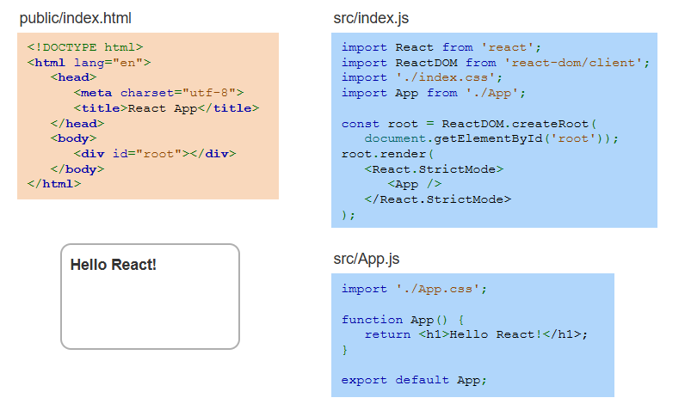
Example
Notes:
This example shows a simplified React project structure. The index.html file contains a root div where React will render content. The index dot JS file imports React and React DOM, then renders the App component inside the root. The App dot JS file defines a simple function returning Hello React inside an h1 tag. This minimal setup helps beginners understand the basics of React. Next, we will explore styling components in React.

